Slide 1
Predictive Modeling of Intimate Partner Violence Using NYC Police Data
Ash Todd, Eaint May, Nora Phelan, Zack Taylor

Slide 2
Introduction
Background: What Is Intimate Partner Violence?
Abuse appears in a variety of forms including: physical, emotional, economic, psychological, sexual, and more.
IPV is a subcategory of Domestic violence
“[P]atterns of coercive behavior that influence another person within an intimate partner relationship” (OVW)
Motivation: Why did we study IPV?
Difficult to predict due to complex psychological and social factors.
historical inequalities shaped by gender, class, and systemic neglect.
Many cases go unreported Inadequate institutional responses Fear of retaliation or disbelief
Notes:
Ash

Slide 3
Research Questions (Intro cont.)
Primary Question:
How can police data be used to develop predictive modeling for combating Intimate Partner Violence and what are the potential biases and ethical concerns that can arise in such use?
Sub Questions:
How does bias shape the data and affect predictive accuracy?
What gets lost or distorted when IPV is viewed through predictive lens?
Who bears the risk when predictive tools are used in already-vulnerable communities?
Notes:
Eaint
What does it mean to make violence “predictable” using data that itself is shaped by uneven policing and systemic bias?
And who bears the risk when predictive tools are used in already-vulnerable communities?

Slide 4
Data
Publicly available domestic violence reports from the NYC Police Department from 2020-2021
Key variables:
Offense Type: Domestic Incident Report (DIR), felony rape, or felony assault
Victim and Suspect Information: Age, sex, race
Location: Precinct code, borough
Data cleaning:
Missing Data: Missing values in financial indicators and ages were replaced with column averages.
Data Types: Age and sex columns were converted to integers; report date converted to datetime.
Felony Classification: A new variable, Felony Offense, was created to classify offenses as felonies (rape, felony assault) or non-felonies (DIR).
Notes:
eaint

Slide 5
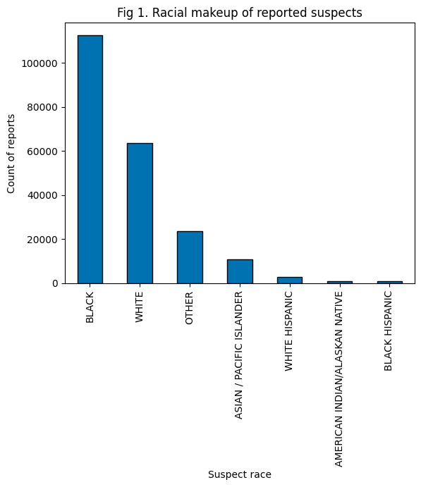
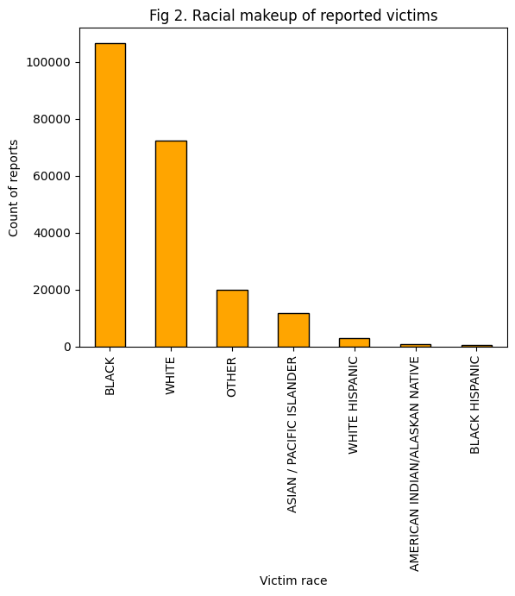
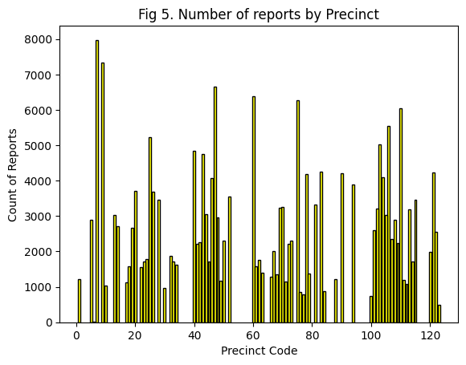
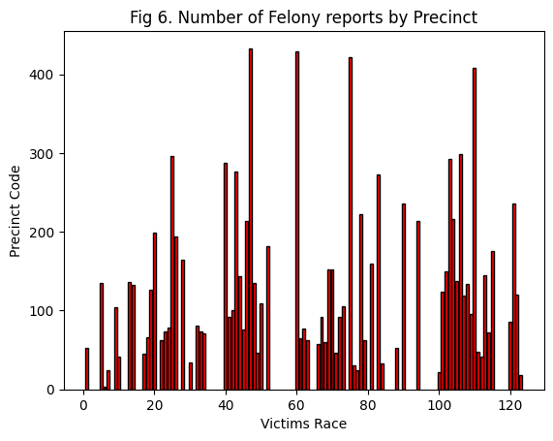
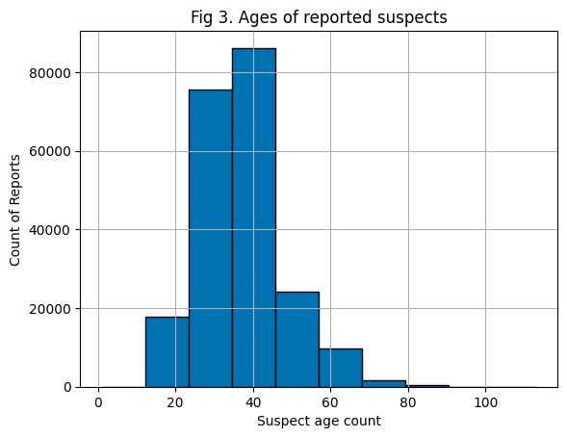
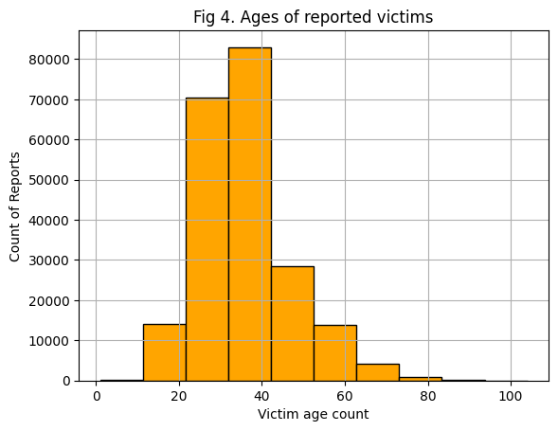
Highlights from EDA
Data Exploration
Suspect and Victim Analysis
Reports by Precinct
Notes:
Ash

Slide 6
Methods
Types of Predictive Policing:
Person-based - Analyzes datasets and generates a list of individuals likely to commit a crime
Place-based - Analyzes datasets to predict where crimes are likely to occur
Our Three Methods:
Place-based -
Found the ten precincts with the highest number of DIRs in a given month
Found the ten precincts with the highest number of felonies in a given month
Compared the lists to identify precincts commonly appearing in both

Slide 7
Methods Cont.
Racial Makeup -
Created chart for racial makeup of suspects in each precinct
Created similar chart showcasing racial makeup of victims in each precinct
Socioeconomic Standing -
Calculated the percent of community districts in each borough that are economically disadvantaged
Calculated the percent of reports in each borough that occurred in these community districts

Slide 8
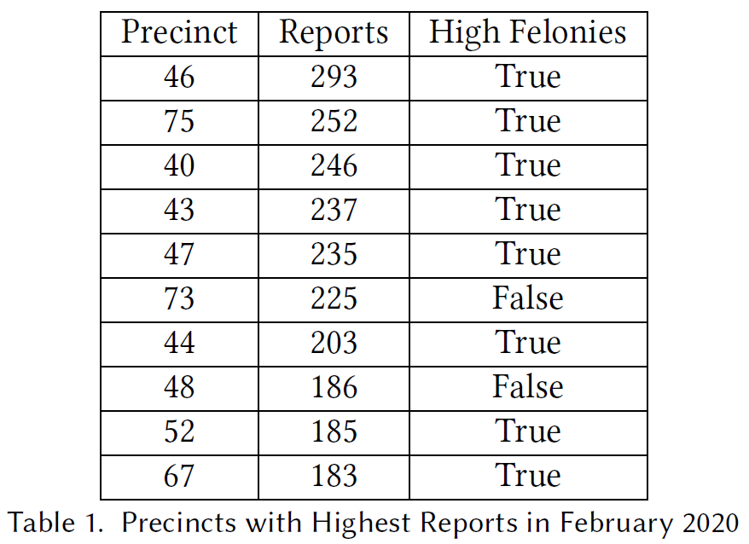
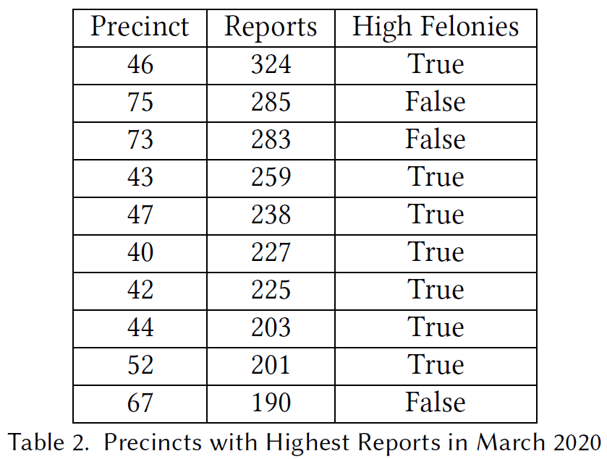
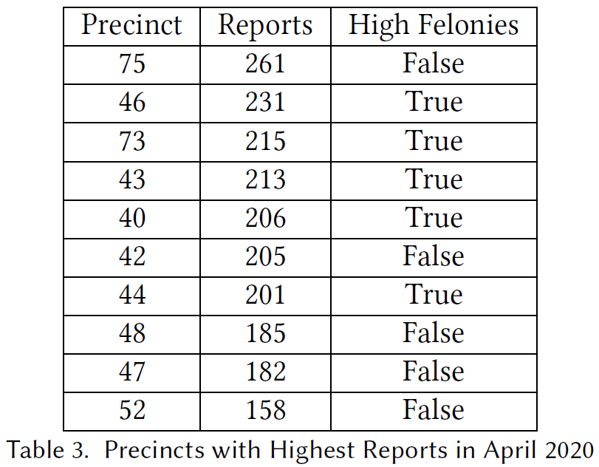
Results - Model
Placed-Based Model: Feb - April 2020

Slide 9
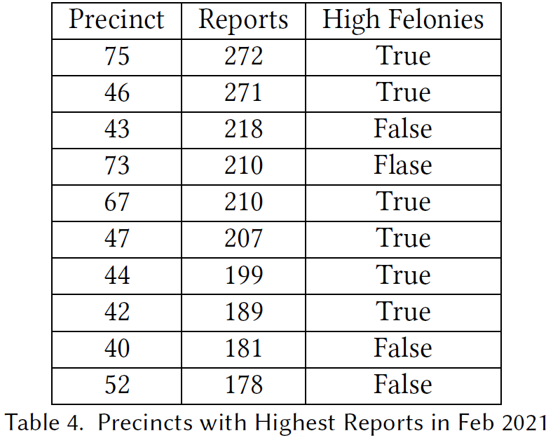
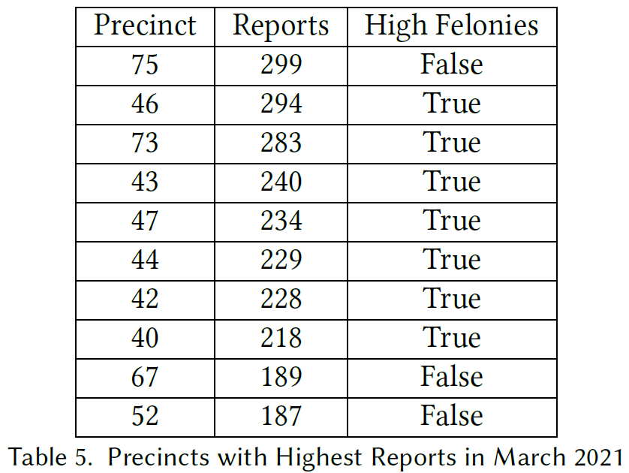
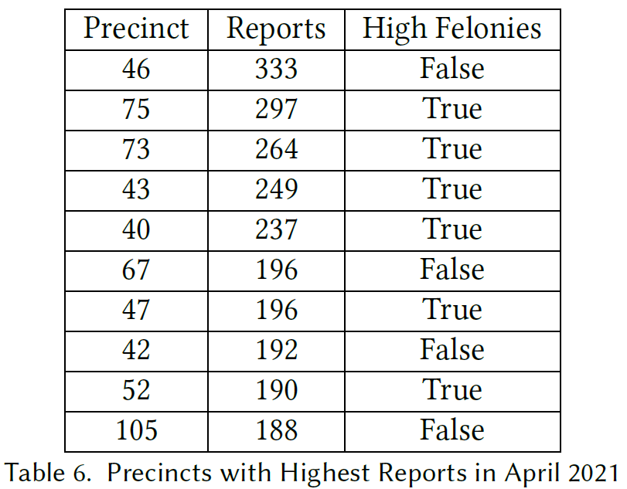
Results - Model Cont.
Placed-Based Model: Feb - April 2021

Slide 10
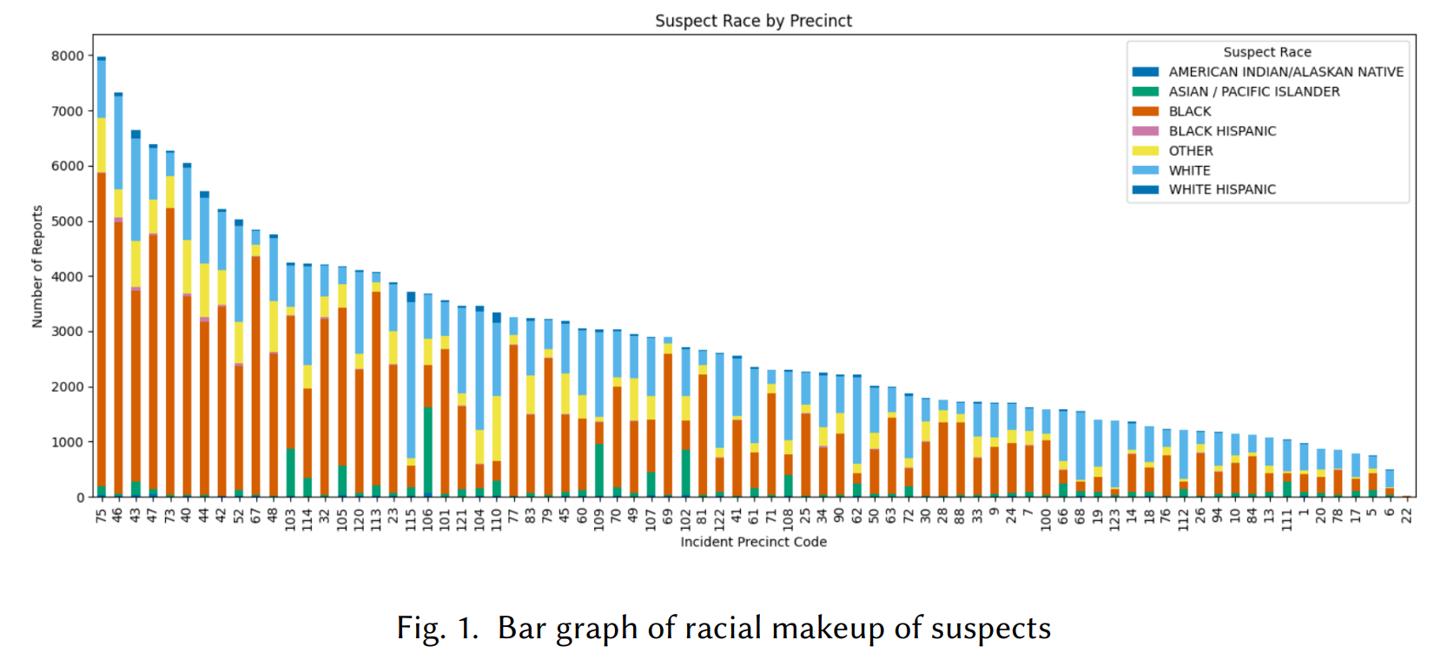
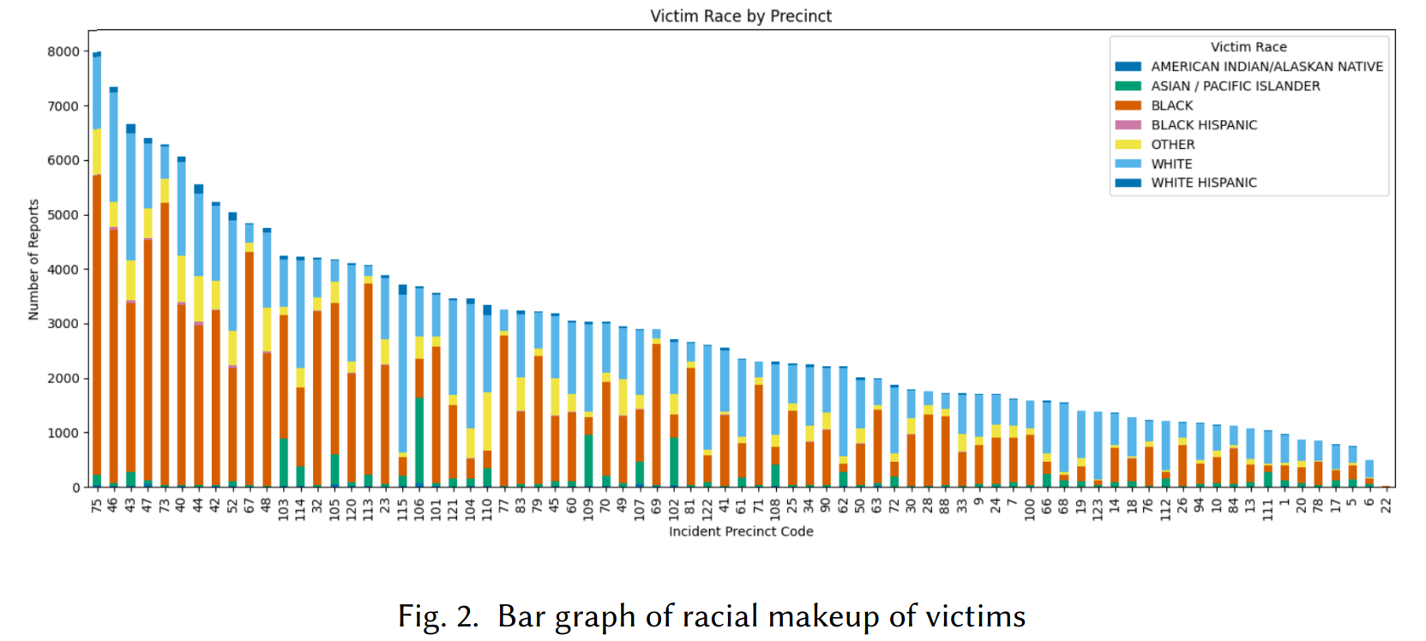
Results - Racial

Slide 11
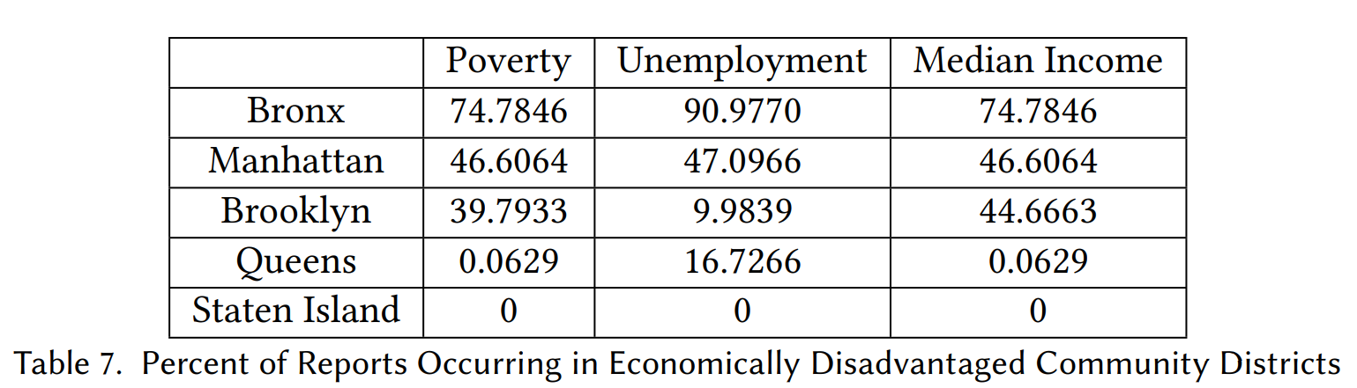
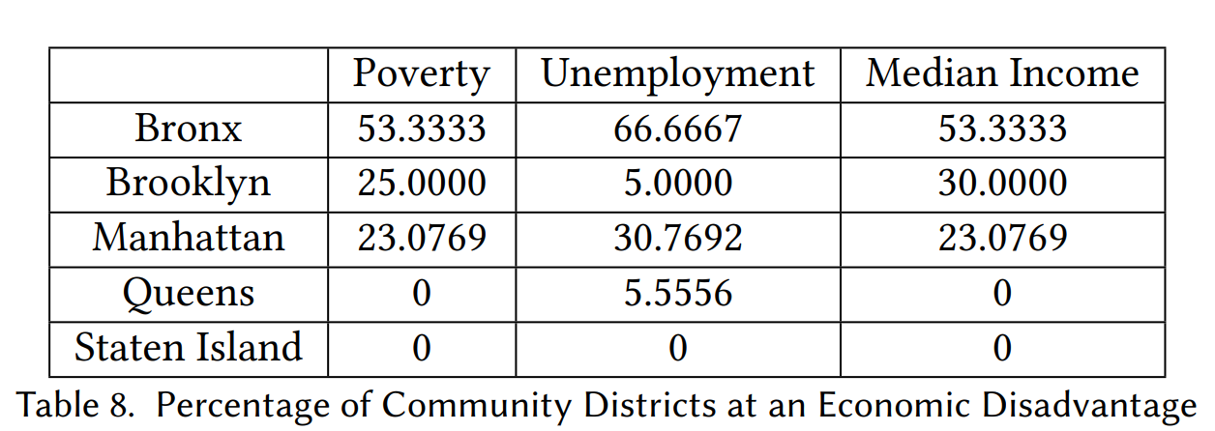
Results - Socioeconomic

Slide 12
Discussion
Key Takeaways
Consistently high report numbers from specific precincts -> disproportionate targeting
Brooklyn and the Bronx
High number of reports from economically disadvantaged districts may indicate systemic bias due to a higher police presence
Systemic racial and economic inequalities -> unethical predictive policing model
Police data alone is not enough
Limitations
Racial disparities in policing
Absence of population data
Community districts, jurisdiction of precincts

